Slide 1


Discovering Android’s Layouts
Asma ELJ , 23/10/2013

Slide 2
Layout?

Slide 3

AbsoluteLayout

Slide 4
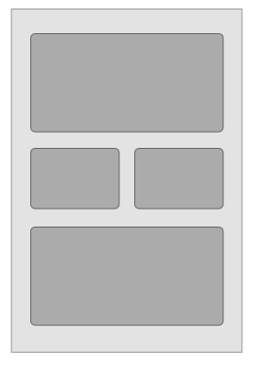
RelativeLayout

Slide 5
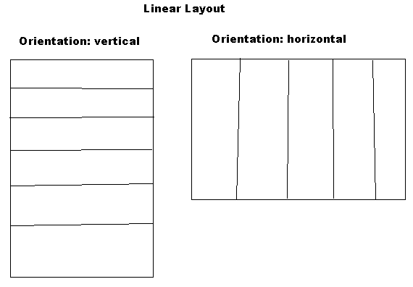
LinearLayout

Slide 6
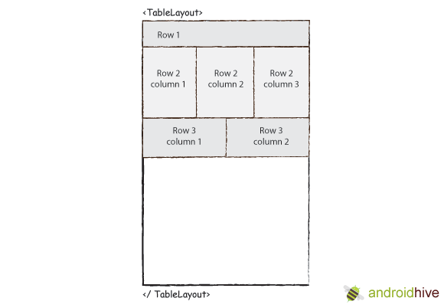
TableLayout

Slide 7
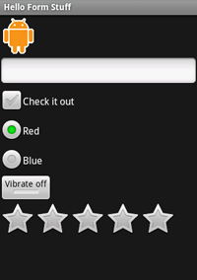
UI Components
Button
ImageButton
EditText
CheckBox
RadioButton
ToggleButton
RatingBar

Slide 8
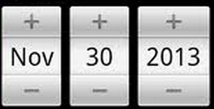
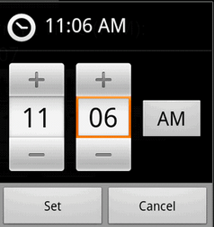
UI Components
DatePicker
TimePicker
Spinner
AutoComplete
….

Slide 9
Let’s try it!

